Slide 1
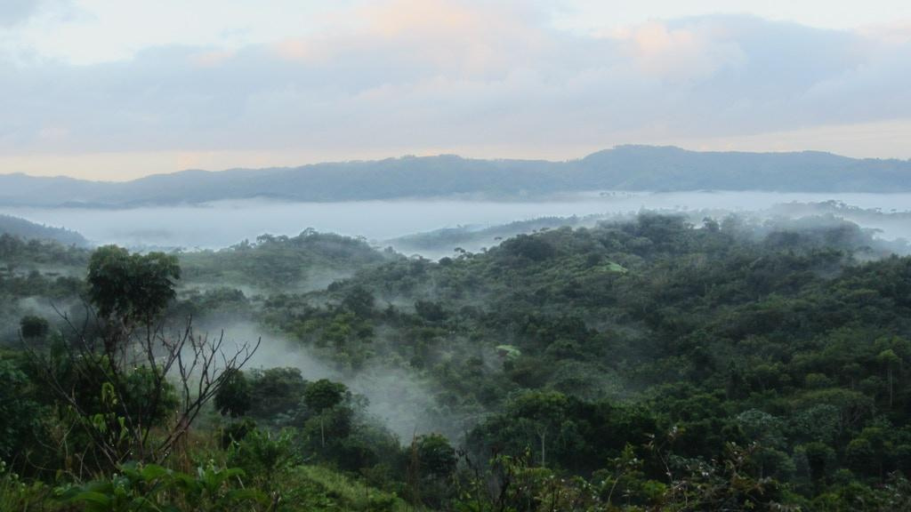
Zorzal Final Presentation
Austin, Mark, Maria, Senem

Slide 2
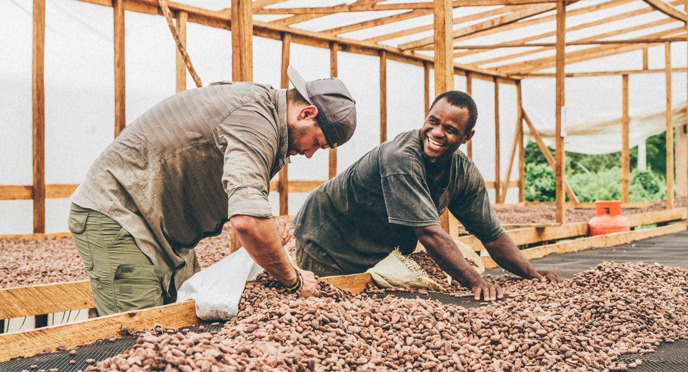
Background Information & The Problem
Zorzal Cacao: cacao producers in the DR, located in a private reserve dedicated to conserving the Bicknell’s Thrush.
Problem: inefficient cacao tracking system
Little transparency
Things get lost
Losing money
Our job: to create a web-app that accurately and efficiently tracks the cacao across the supply chain

Slide 3
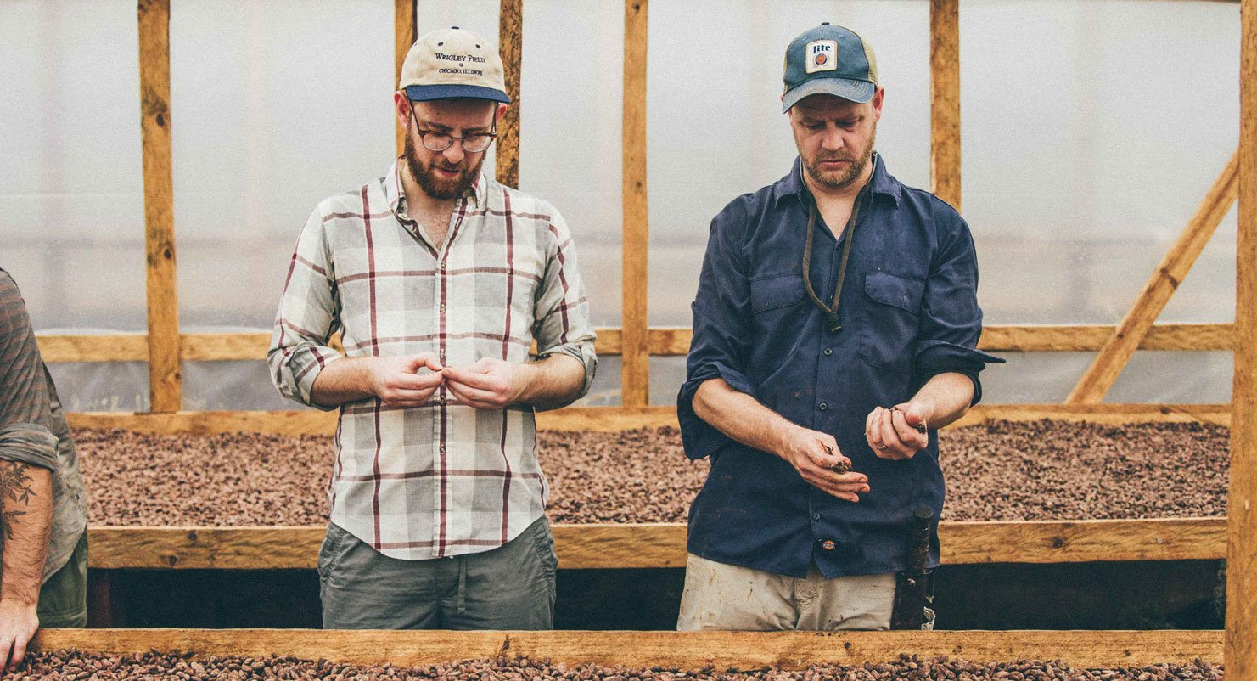
Users
Floor workers scanning packages in and out
Quality control managers
Management/data analysts
accessing raw data to evaluate trends
Zorzal Customers

Slide 4
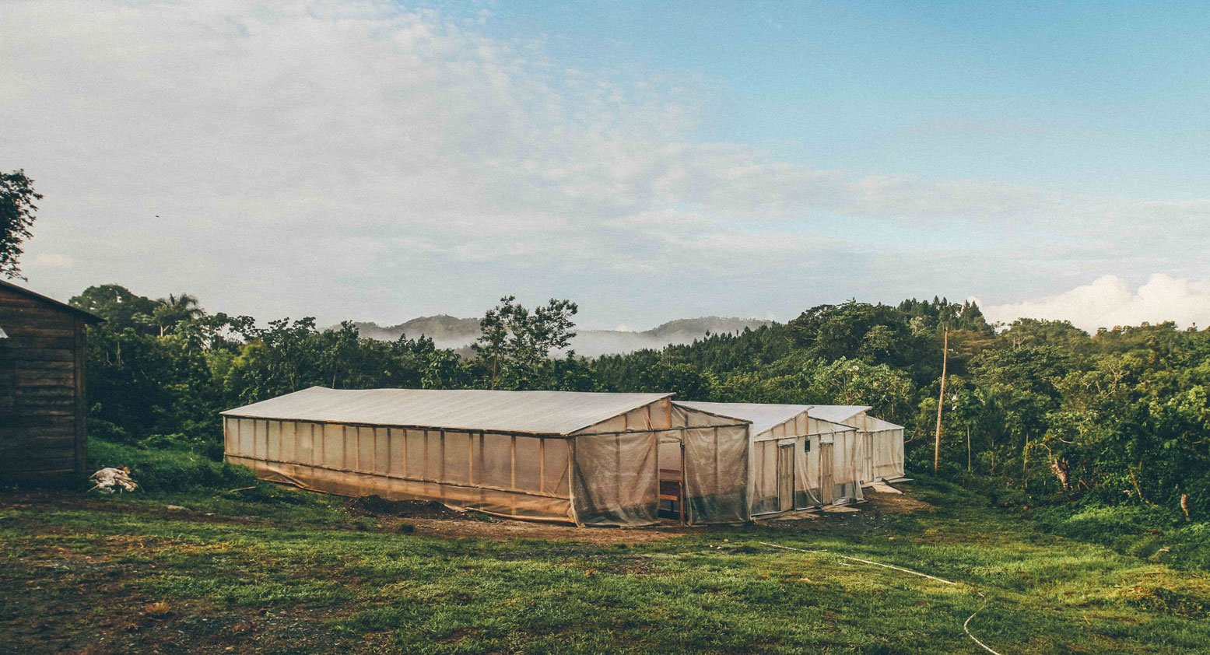
Stakeholders
Zorzal
Oko Caribe
Farmers and the Reserve
Ministry of Environment and Natural Resources
Ministry of Agriculture

Slide 5
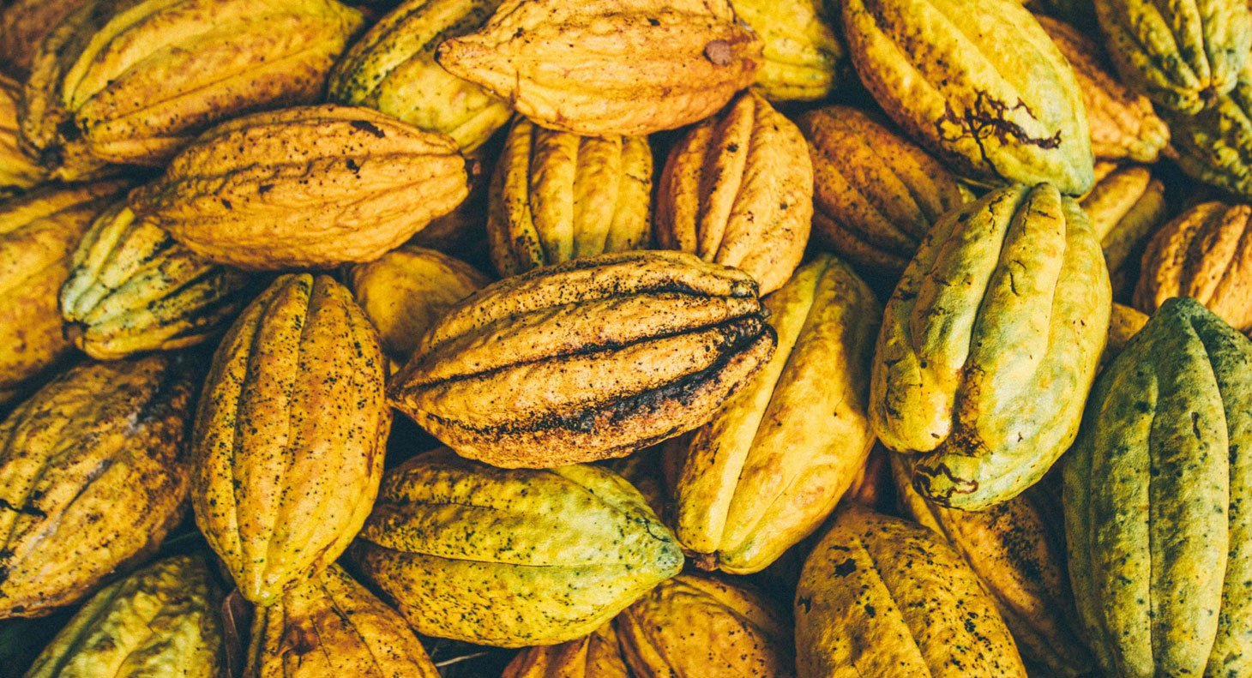
User Requirements &
Technical Specifications

Slide 6
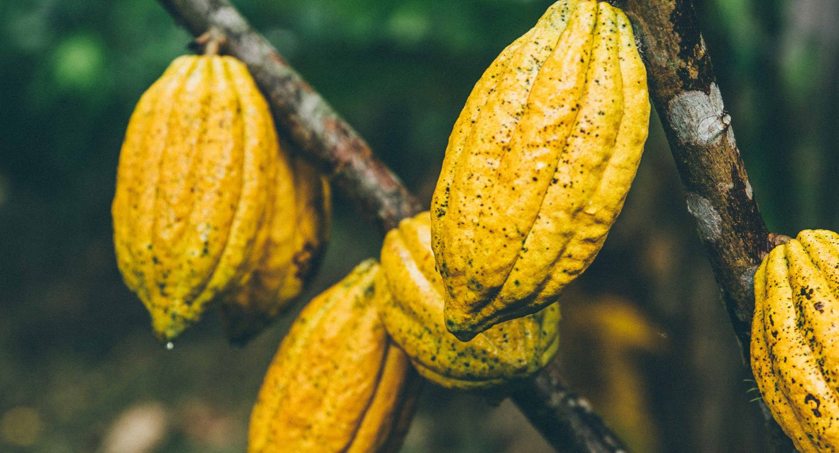
Performance
Easy to understand and learn
Accuracy, Fault- tolerant
Convenience Intuitiveness
Fast Data Entry

Slide 7
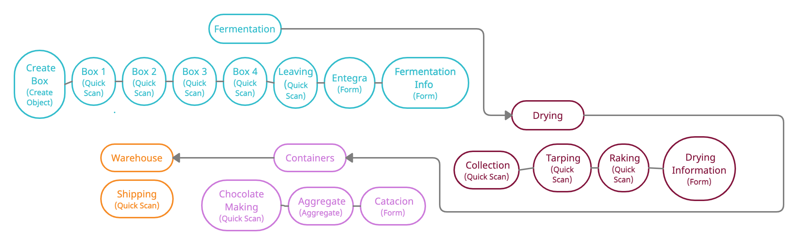
Supply Chain Step by Step

Slide 8

Features
Barcode generation and scanning
Ability to enter additional finer data with forms
Data display and product lookup

Slide 9
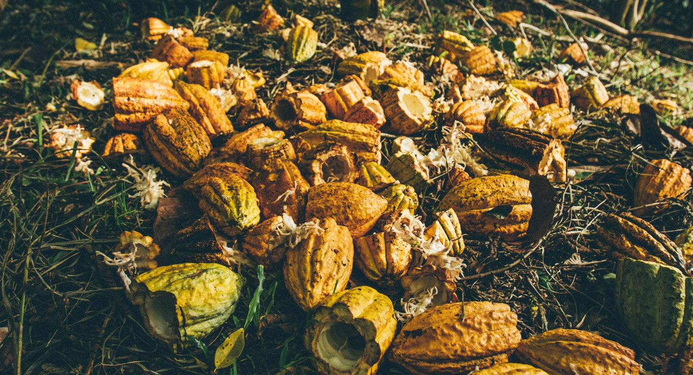
Environment Operating System
Tolerance to limited internet connection
Reliability, Minimal Maintenance
Sustainability

Slide 10
Supply Chain in terms of Checkpoints, Actions, and Units

Slide 11

Prior Work & Progress

Slide 12
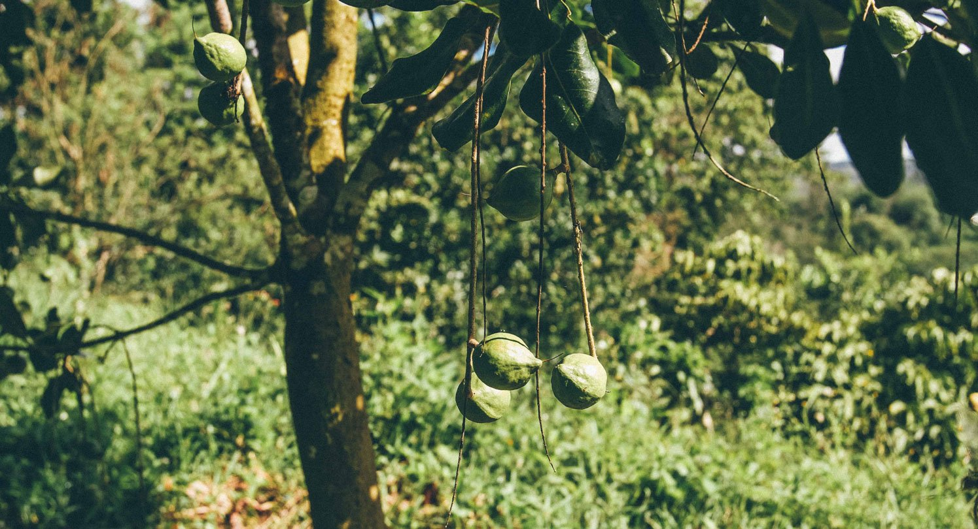
Last Year’s Prototype
Functional
Could Theoretically Track Cacao
Allowed for Form Entry
Not Robust
Not Intuitive
Most Importantly not Sustainable

Slide 13
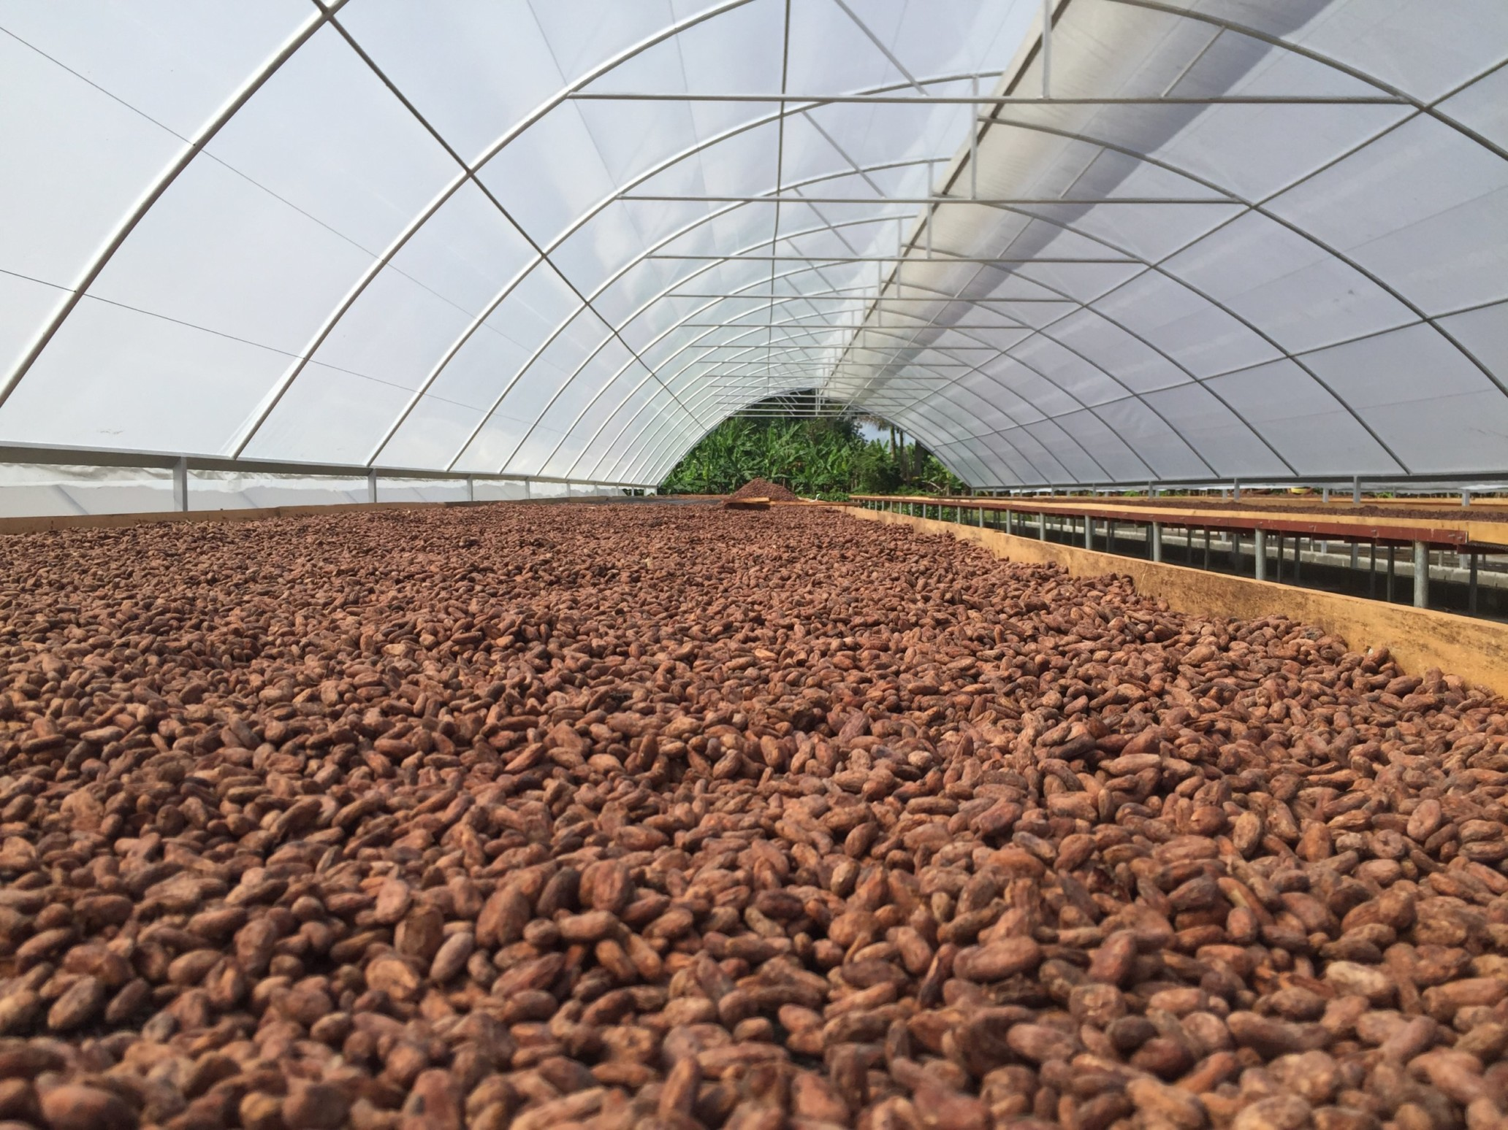
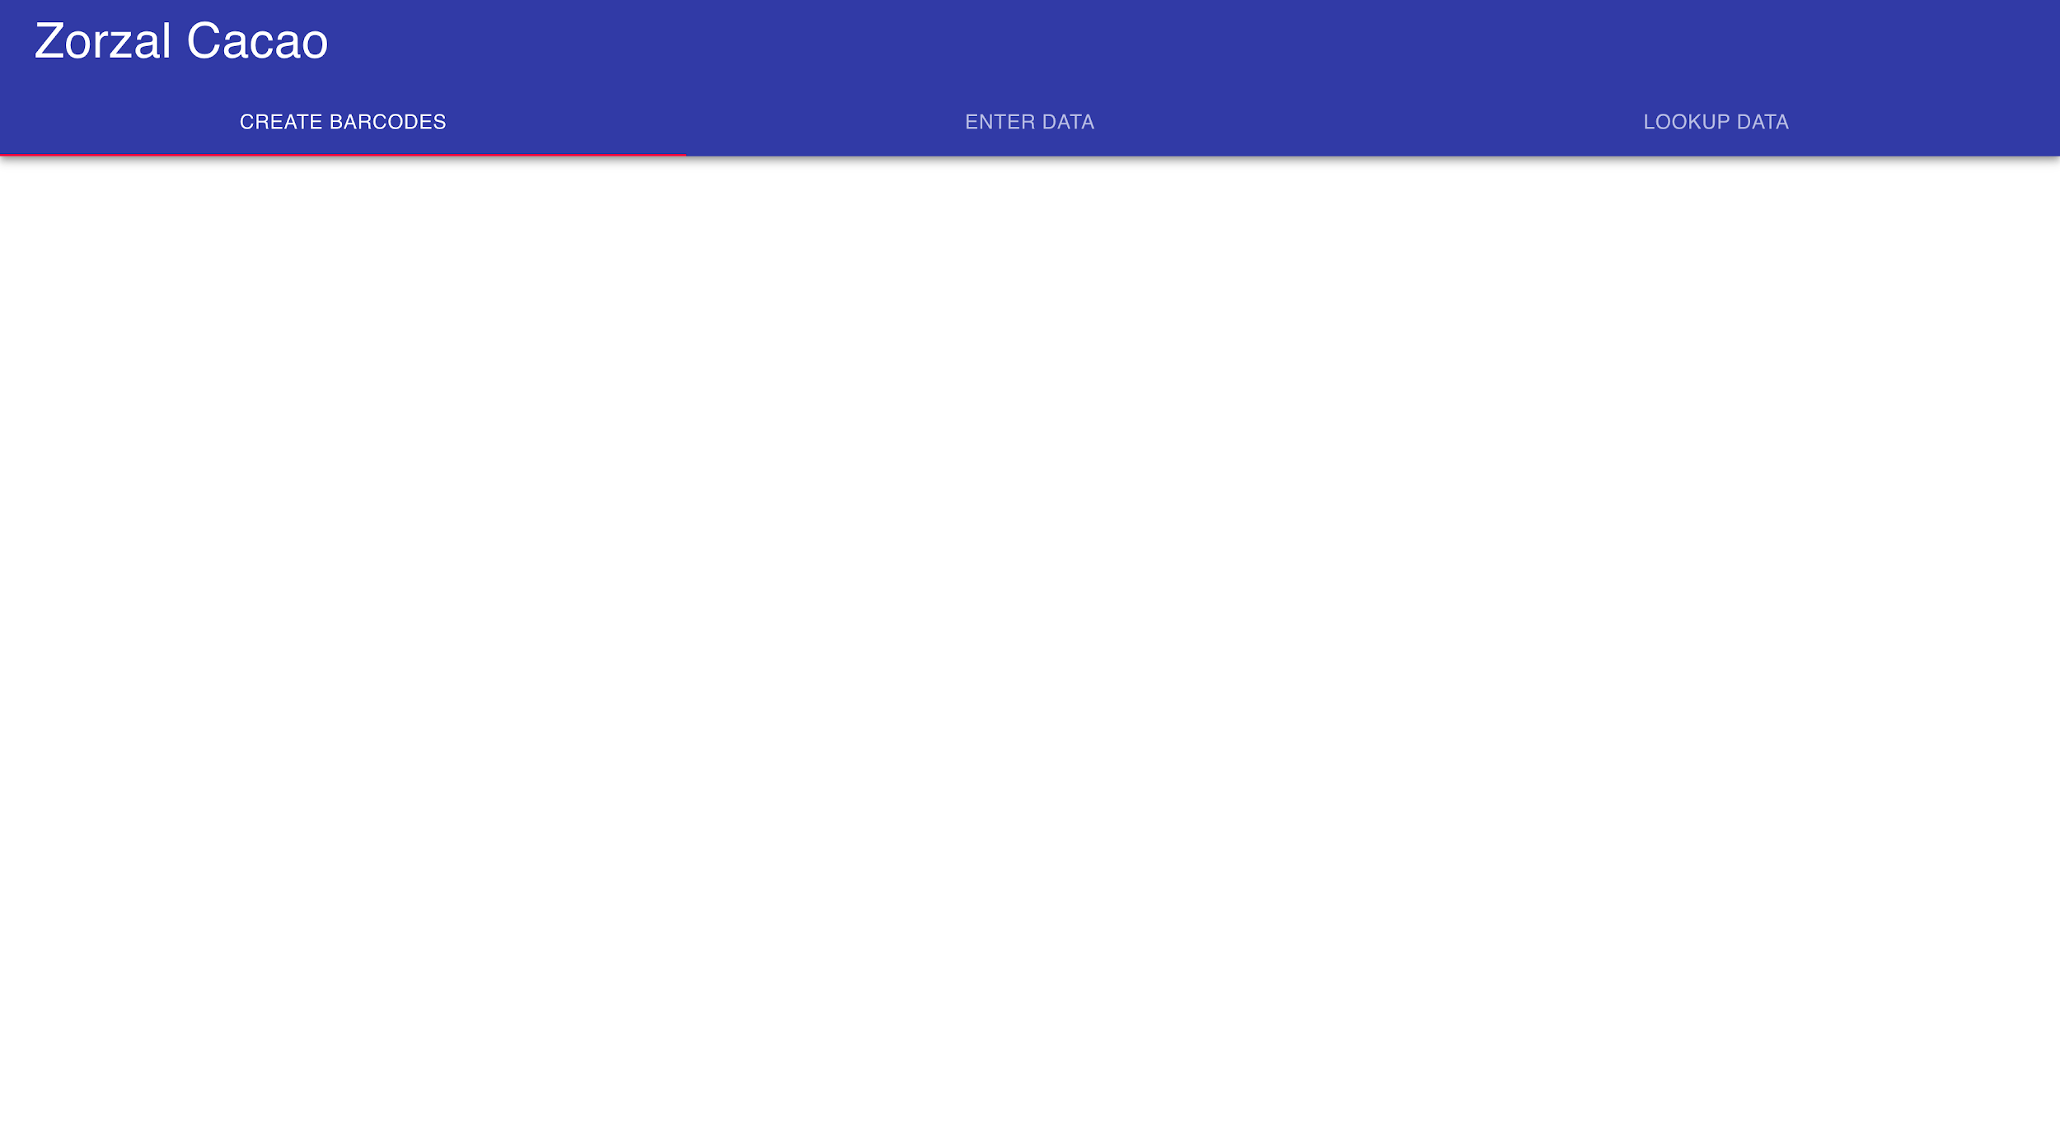

Slide 14
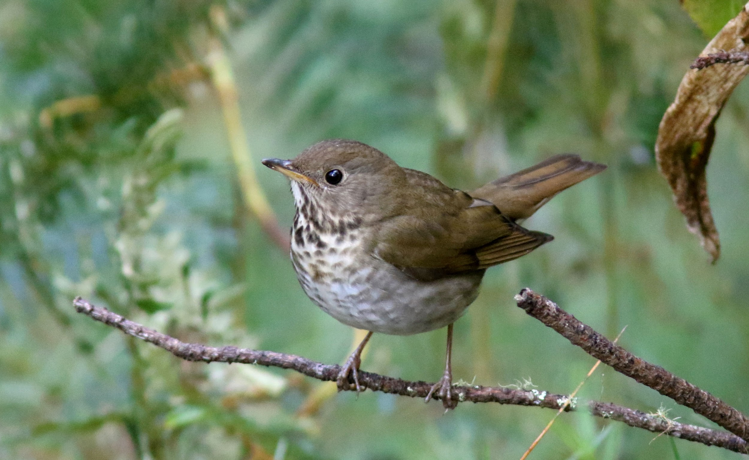
This Year’s Version
Emphasis on Sustainability of the Codebase
More Robust
More Intuitive

Slide 15

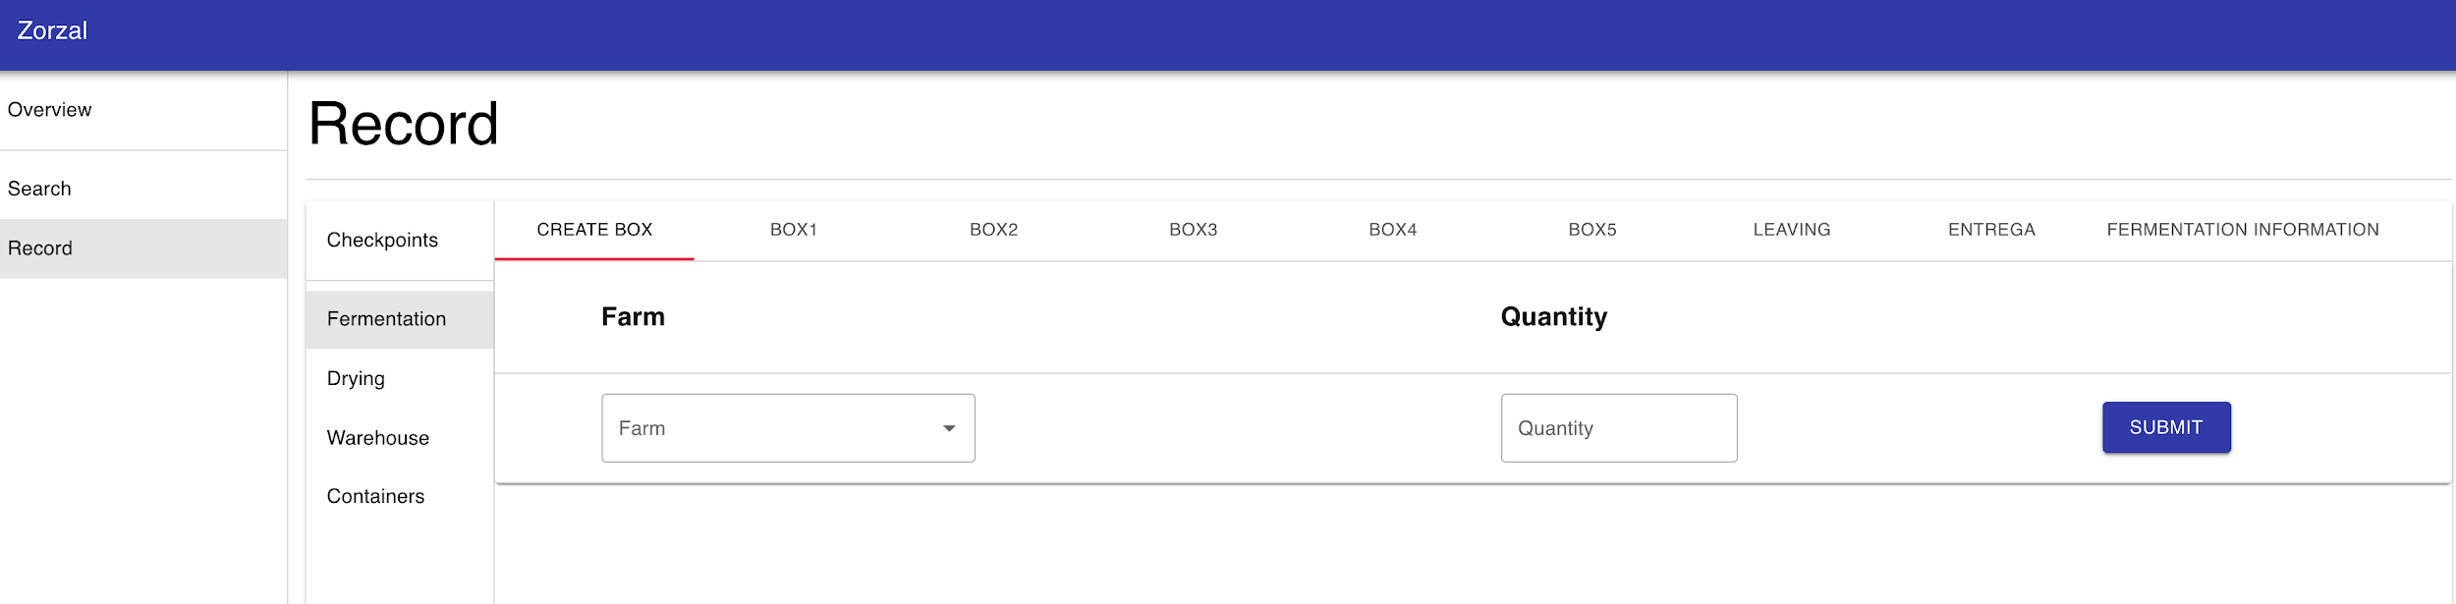

Slide 16
Testing
Started Testing Recently
Working on Incorporating Feedback from Tests
Trying to Encourage Early Adoption of App

Slide 17
Challenges and Reflections
Accelerated timeline
Cacao season put pressure to integrate app earlier than planned
Rolled out features week by week to allow earlier use and feedback
Differences in prior experience
Challenge we were aware of coming into the project
Addressing by providing additional resources and incorporating onboarding into development that isn’t time sensitive
Ensuring representation of end-user needs
Communicating primarily with Chuck overemphasized his needs for the app’s form and function
Direct communication with workers now occurs via WhatsApp

Slide 18
Next Steps - Short Term
Develop mobile layout
End of spring break for initial version
Leverages majority of existing code
Provide comprehensive form layout
End of spring break
Encompasses only visual display - data collection and storage already implemented
Begin regular data exports
End of spring break for initial version
Exploring Google Sheets API
Enable app-wide language settings
Week 2 of spring quarter
Lowest priority because forms are already in Spanish

Slide 19
Next Steps - Long Term
Offer in-app configuration
Primary goal for spring quarter
Necessary for long term use
Establish comprehensive documentation and test coverage
Prevent oversights when introducing changes
Documentation attached to code base facilitates future development and maintenance
Established project documentation readily available on large projects
Ongoing revision and bug fixes

Slide 20
Thank you!

